Slide 2

Leading for
Employee Engagement
Building an Engaged Workforce
Notes:
Please make polling questions out of slides: 5, 11, 18. and 20. Please make it so they can answer more than one choice in each question.

Slide 3
Agenda
International Research
Engagement Solutions
Case Studies

Slide 4

Research Sources
Corporate Leadership Council on
Employee Engagement:
  50,000 Employees
  59 Companies
  27 Countries
  10 Industries
SHRM Study on Productivity and Engagement
National Opinion Research Center
Gallup Study on Employee Engagement
Melcrumb UK
Watson Wyatt
Towers Perrin
ISR
Performance Connections International

Slide 5

Five-Factor Definition of Employee Engagement
Believe in and support the goals and objectives of the business
Feel a sense of belonging to and pride in the company
Are willing to go the extra mile to ensure that personal contributions help the department and overall organization to be successful
Find Value, Create Value, Feel Valued
Resilient and Change-Ready

Slide 6
Poll: Why Do You Care About Engagement?
Conducted an engagement survey and we can do better
Going through significant change and want to keep our employees engaged
Want employees to be engaged in our business strategy
Our C-Suite Exec’s care about employee engagement
Honestly, I don’t think my company cares very much about employee engagement

Slide 7

Employee Engagement Data
Believe in Goals and Objectives
Pride and Belonging
Find, Create, Feel Valued
Go Extra Mile
Resilient and Change-Ready
13%
76%
11%
Actively Disengaged
“Up for Grabs”
Actively
Engaged
The Lack of Engagement Can Be Masked By Low Turnover and Long Work Hours

Slide 8

Highly Committed & Engaged
Best Companies: Highly Engaged = 24%
57% More Discretionary Effort
87% Greater Intention to Stay
71% Higher Revenue (Industry Av)
11%
Lowest Companies: = 3%
Actively Engaged

Slide 9
Segmentation Differences
Size of company did not matter
Industry did not matter
Demographic factors (gender, age, geography, job, tenure, level) did not change the results

Slide 10
Further Engagement Research
The reduction in employee engagement costs US-Based businesses over $270B dollars a year (Gallup)
Increasing employee engagement by 5 % can add 2.4 % to a business’ operating margin (Towers Perrin)
Lower levels of engagement can erode operating margin AND net profit by 1-2% (ISR)
Superior human capital practices are a leading indicator of financial performance; significant HC improvements lead to up to 47% increase in shareholder/market value (Watson Wyatt)
Psychologists report that one of the most important keys to happiness is ….. engagement (Journal of Applied Psychology)
Notes:
Conclusion, we are not just addressing the issue of emotional engagement, we are addressing the issues of bottom line company performance

Slide 11
Engagement Affects Empowerment
Beliefs | Highly Engaged Employees | Disengaged Employees
I can have a positive impact on company's products | 84% | 31%
I can positively affect the customer experience | 72% | 27%
I can positively impact costs/profitability | 68% | 19%

Slide 12
Poll: How Engaged Are Your People?
Over 25% are Actively Engaged
About 25% are Actively Engaged
10-15% are Actively Engaged
Less than 10% are Actively Engaged

Slide 13
Employee Engagement
Example 1:
  Engineer is passionate about his work and puts in long discretionary hours
  Problem: He is working on his pet project that has little to do with the strategic direction of the company
Example 2:
  A salesperson has good relationships and even personal friendships with her customers and is passionate about her products.
  Problem: She is not prospecting to new more strategic target segment and not selling the company’s newest products
Aimless Engagement

Slide 14
Engaged in What?
Employees can be aimlessly engaged in the wrong things
Engagement is not a goal that should be pursued independently of your business direction
Engagement must be grounded in:
  Strategic Priorities
  Significant Change Efforts
  Critical Business Goals
  Brand Promise
  M&A Integration
  Reorg’s
  New Product/Market Success
  New Sales/Service Strategies
Anything else runs the risk of being perceived as an “HR” activity disconnected from the business

Slide 15
At Performance Connections
We have branded this as
“Aligned Engagement”

Slide 16
Why Most Executive Messaging Does Not Go Far Enough to Build Aligned Engagement
Meaningful executive communication is very important but difficult
“Semantic gap” – the gap between what the executive intends as the message and what
the people hear
Example: Executive says: “We need to get better at prioritizing and streamlining.”
The masses hear: “We are going to have lay-offs.”
Evidence

Slide 17
The Alignment Gap
Franklin Covey Survey of 11K Managers and Employees
___ % of businesses that say that the activities of their front line employees are well connected to the company strategy
___ % that say that the activities of their upper level managers are aligned with their strategy but that the activities of the rest of their employees are NOT
___ % say they understand their company’s most important goals
___ % employees believe their work has a strong link to org top priorities
29
61
44
9

Slide 18

Strategy Alignment
Ladder
They do their jobs differently -- change behavior to align with it
They have a clear line of sight about how it affects them
They buy into it
They understand it
They know what it is – can repeat it back

Slide 19
Poll: Do You Have Aligned Engagement?
The significant majority of our employees:
They do their jobs differently -- change behavior to align with the strategy
They have a clear line of sight concerning how our strategy affects their daily work
They buy into our strategy
They understand our strategy
They know what our strategy is – can repeat it back accurately

Slide 20

The 10:6:2 Rule
Best Companies: Highly Engaged = 24%
The 10:6:2 Rule ¹
Every 10% Increase in Aligned Engagement
Yields 6% Increase in Discretionary Effort
Yields 2% Increase in Company Performance
Actively Engaged
¹ Corporate Leadership Council

Slide 21
Observations
Many businesses conduct employee engagement surveys but don’t measure aligned engagement
Some organizations collect engagement survey data but don’t take enough aggressive action
Some businesses deploy post-survey action teams but fail to provide a critical mass of managers with engagement tools
Many engagement solutions unknowingly focus on aimless instead of aligned engagement
Businesses that focus on building aligned engagement enjoy a positive bottom line impact

Slide 22

Drivers of Engagement
Studies identified 300 Drivers
These Engagement Drivers hold true regardless of level, function, occupational group, age, and industry
The top 50 Drivers have 40 times more impact than the rest (Pareto Principle)
The presence or absence of these Engagement Drivers are influenced by leadership - top to bottom, and the employees themselves
Factor analysis indicates that the roots of these top drivers fall into three categories

Slide 23

The Roots of Aligned Engagement
Sense of Pride
Sense of Belonging
Resiliency
Believe in Strategy
Find, Create, Feel Value
Accountability
Enduring Purpose
Change-Readiness

Slide 24
Accountability
Accountability = Ownership = Engagement
To build an aligned and engaged workforce, managers must learn how build employee ownership in the business’ key imperatives
This is in contrast to allowing employees to operate in a way that is disconnected from the big picture, OR creating a punitive environment that discourages ownership
Actions you can take:
  Translate strategic imperatives/change initiatives into behaviors
  Integrate behaviors into daily work requirements
  Hold performers accountable
  Use long/short term performance management processes

Slide 25
Change-Ready
Change-Readiness is a prerequisite for sustaining engagement
Represents Strategic Agility
A company’s readiness to evolve doesn’t necessarily match the workforce’s readiness
to change
Most change efforts fall short of expectations because organizations don’t know how to help employees change their behavior
Actions you can take:
  Assess readiness to change behaviors
  Focus on honest and open dialogue vs. mandates
  Ask employees what they need to be more ready to change

Slide 26
Enduring Purpose
Sense of Purpose = reasons for working other than compensation
The greater the sense of aligned purpose, the higher the levels of aligned engagement
Take action to build aligned purpose in four dimensions:
  Connection With The Organization
  The Work Itself
  The Contributions Employees Make
  Relationships with Others

Slide 27
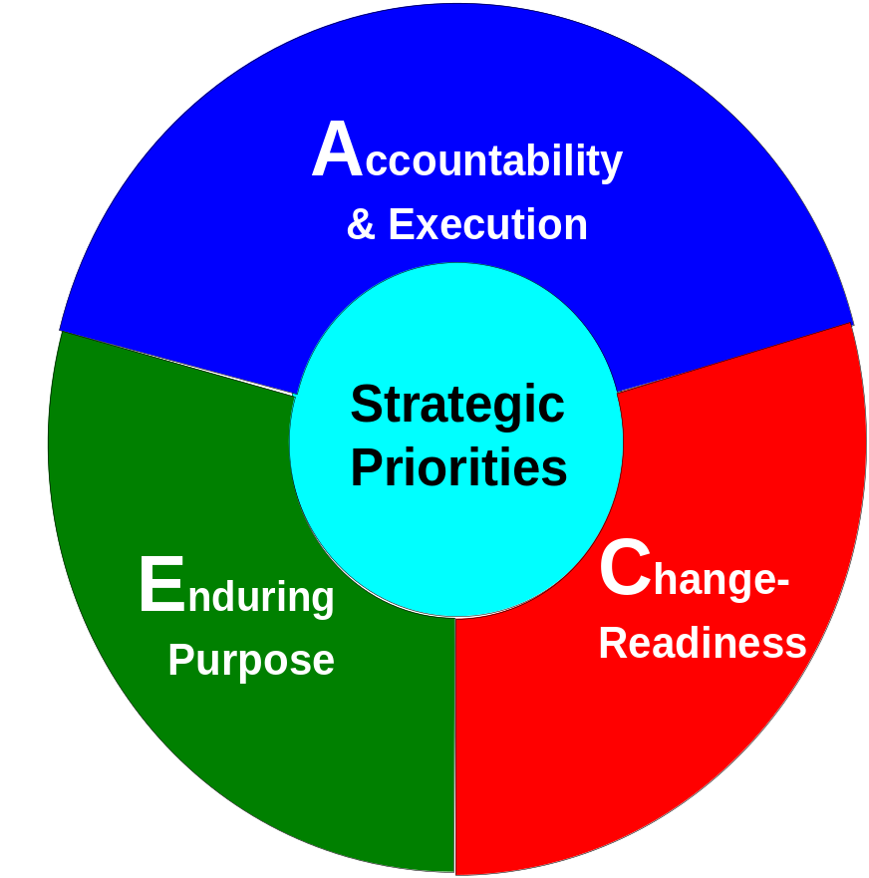
A System for Aligned Engagement

Slide 28
Case 1
Financial Firm Desired Change: Shift from Passive Sales To
Proactive Sales and Service
Financial Advisors believed the business would come through passive referrals and word of mouth
Helped the firm to identify a new sales model and developed new business behaviors linked to the new vision
Results:
  Proactive outbound calls to start new sales cycles increased 350%
  Referrals increased 130%
  Contacts with new prospects increased 150%
  Number of initial prospect meetings increased 112%
  Revenue from new accounts increased 56%
Sustained results one year later

Slide 29
Case 2
Global microelectronics engineering and manufacturing business
Introduced new strategy going from low margin high volume commodity products to low volume high margin leading technology
Required engineers to create different products; salespeople to call on different buying centers; and new manufacturing strategies
Two years after the announcement of the new strategy:
  Salespeople still selling the old products,
  Engineers still making the old products;
  Everyone still skeptical about the new strategy
Performance Connections worked with them to get employees engaged in the new strategy
One year later:
  Engagement Survey increase in every measure of engagement
  Over 150 new products in the leading technology model
  Fourth quarter revenues were 22.6 % higher than the revenues recorded in the fourth quarter of previous fiscal year
  Gross margin hit an all-time high of 61.4 percent, up from 54.7 percent from the previous year

Slide 30
Five Actions You Can Take To Build Engagement
Measure levels of aligned engagement
Educate leaders about the business impact and their role in employee engagement
Build employee ownership for strategy realization by linking them to the big picture and effectively managing execution
Develop workforce change-readiness
Help employees connect their personal sense of purpose to a higher organizational purpose

